Slide 1

Azure Resource Manager 101
Stijn Callebaut Kurt van Hoecke
Inovativ Inovativ
@StijnCa @Bunkco
CDM MVP

Slide 2
Session objectives
Get an understanding of Azure resource manager
Discover the tools
Deploy a VM using an ARM template
Use PowerShell ARM^{[1]} (and forget about ASM^{[2]})
^{[1]}ARM = Azure resource Managent REST API
^{[2]}ASM = Azure Service Management REST API

Slide 3
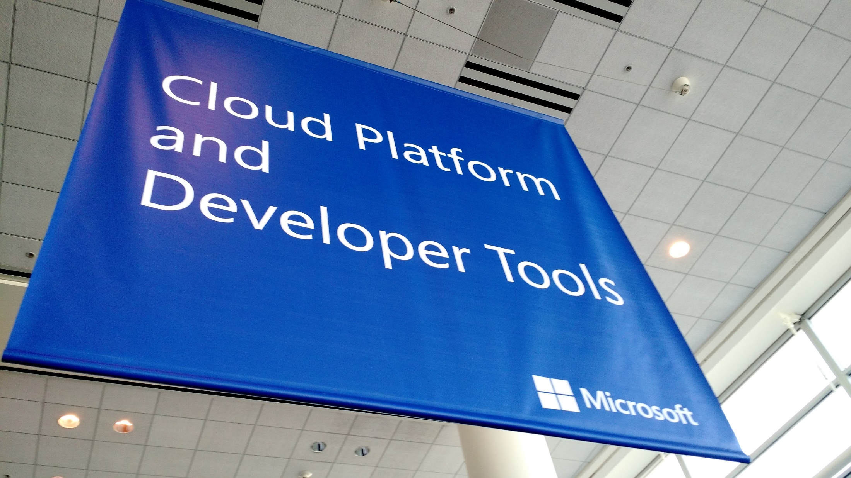
Why the need

Slide 4
Current Challenges
Deploy single resources
Set Permissions
Monitor and alerting rules
Billing
Deployment
Lifecycle management
…
?

Slide 5
Resource Groups
Coupled containers of multiple resources
Resource dependencies
Can span regions
One view monitoring
Central resource biilling
RESOU
R
CE G
R
OUP

Slide 6
Resource Group Lifecycle
one Resource group
or
different resource groups?
IT ALL DEPENDS

Slide 7
DEMO

Slide 8

our first deployment template

Slide 9
Infrastructure as Code
DEVELOPMENT
Value
Deployment Optimization
Accelerate Delivery
Idempotent
Version control
CODE
ACCEPTANCE
Measure
Deployment Rate
IT
PRODUCTION

Slide 10
Deployment Templates
SQL-A
Instantiation of repeatable config.
Configuration → Resource Group
What?
Source control
Specifies resources, dependencies, and connections
Parameterized input/output
Why?
Ensure Idempotency
Simplify Orchestration
Provide Cross-Resource Configuration and Update Support
Website
[SQL CONFIG] VM (2x)
DEPENDS ON SQL
DEPENDS ON SQL
SQL - A
Website
Virtual
Machines
SQL
C
ONFIG

Slide 11
Tools
(preview) Azure Portal
Visual studio (community edition = FREE)
Visual studio Code (multi platform = FREE)
Sublime text
Notepad++
….

Slide 12
Some best practices
Use parameters
Use variables for common configuration
Split common configs
Consistent in attribute order
Use secrets
"resources": [
{
"name": "<name-of-the-resource>",
"type": "<resource-provider-namespace/resource-type-name>",
"apiVersion": "<api-version-of-resource>",
"location": "<location-of-resource>",
"tags": "<name-value-pairs-for-resource-tagging>",
"dependsOn": [
"<array-of-related-resource-names>"
],
"properties": "<settings-for-the-resource>"
"resources": [
"<array-of-dependent-resources>"
]
}
]

Slide 13

our first deployment template

Slide 14
More specific, we’ll deploy a:
Windows Virtual Machine
With a variable size (A1-A10)
In a specific region
… and install the web role

Slide 15
DEMO

Slide 16
demo
Create out template in visual studio (use snippets to prevent to many errors)
Notes:
Todo: create template live. Everything in snippets ☺
Info:
https://github.com/Azure/azure-quickstart-templates/tree/master/101-create-key-vault
https://github.com/Azure/azure-quickstart-templates/tree/master/101-simple-windows-vm
https://github.com/Azure/azure-quickstart-templates/tree/master/windows-vm-push-certificate
https://github.com/Azure/azure-quickstart-templates/tree/master/201-vm-domain-join

Slide 17
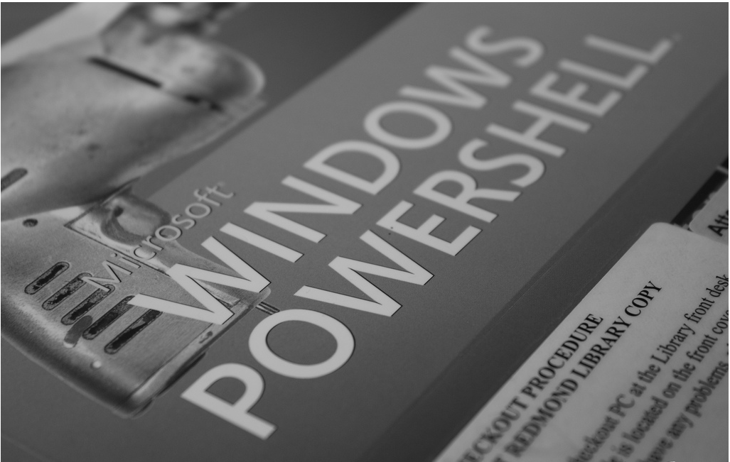
PowerShell and the case of ARM

Slide 18
DEMO
Notes:
Same thing as template but in powerShell
http://blogs.technet.com/b/keithmayer/archive/2015/07/07/18-steps-for-end-to-end-iaas-provisioning-in-the-cloud-with-azure-resource-manager-arm-powershell-and-desired-state-configuration-dsc.aspx
http://blogs.msdn.com/b/cloud_solution_architect/archive/2015/05/05/creating-azure-vms-with-arm-powershell-cmdlets.aspx
IMPORTANT:
https://github.com/Azure/azure-powershell/wiki/Deprecation-of-Switch-AzureMode-in-Azure-PowerShell

Slide 19
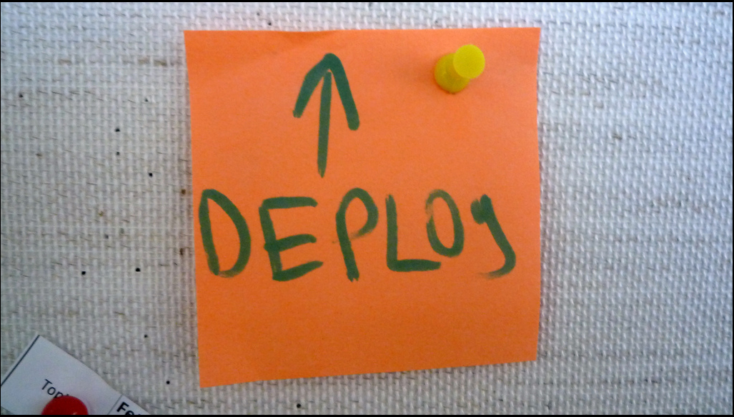
Additional resources to get started

Slide 20
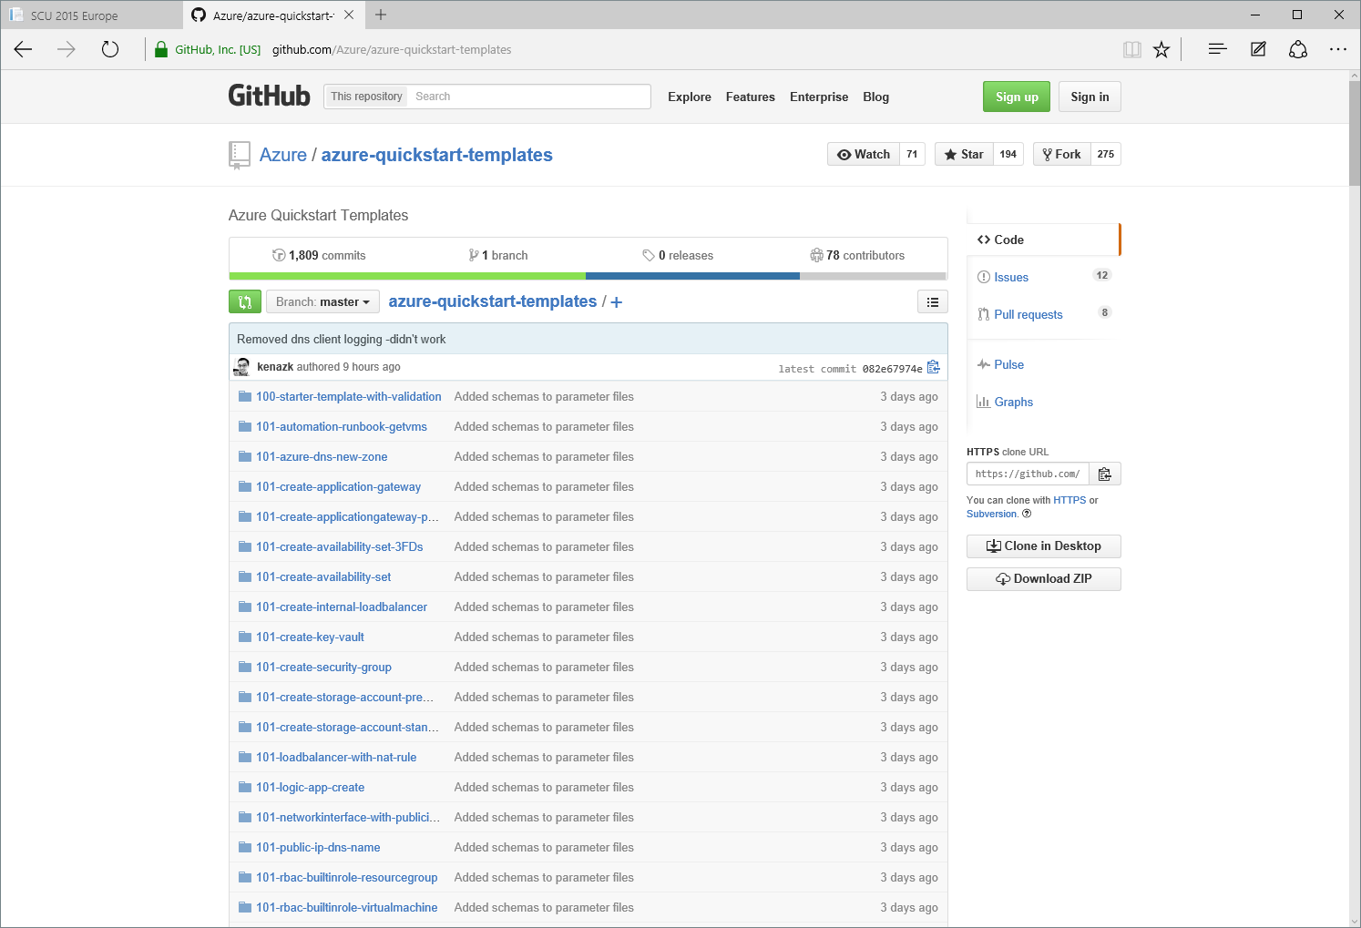
Getting started
Notes:
Github Quickstart templates

Slide 21
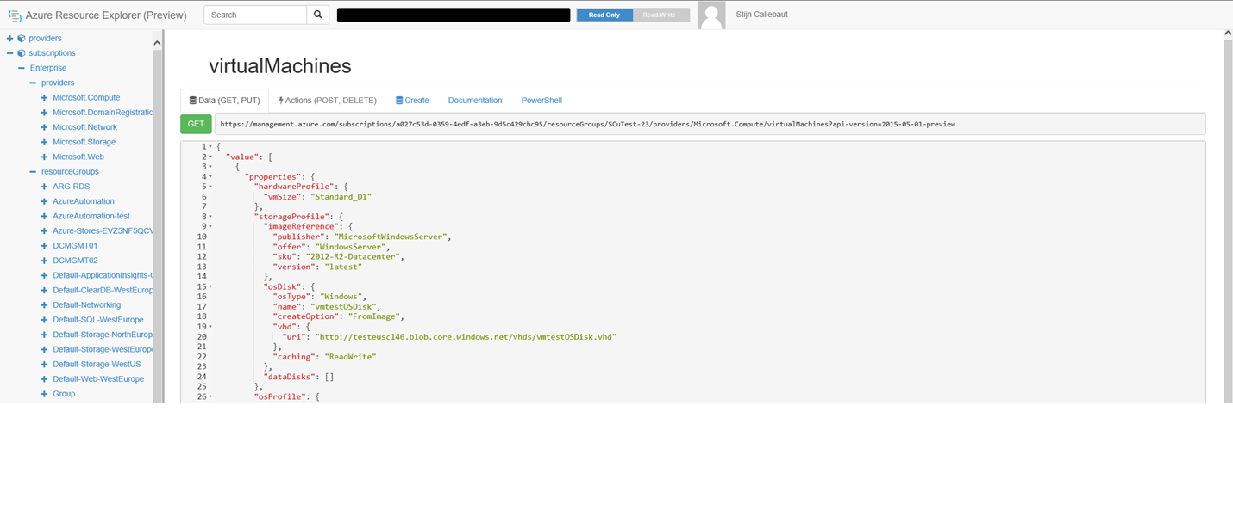
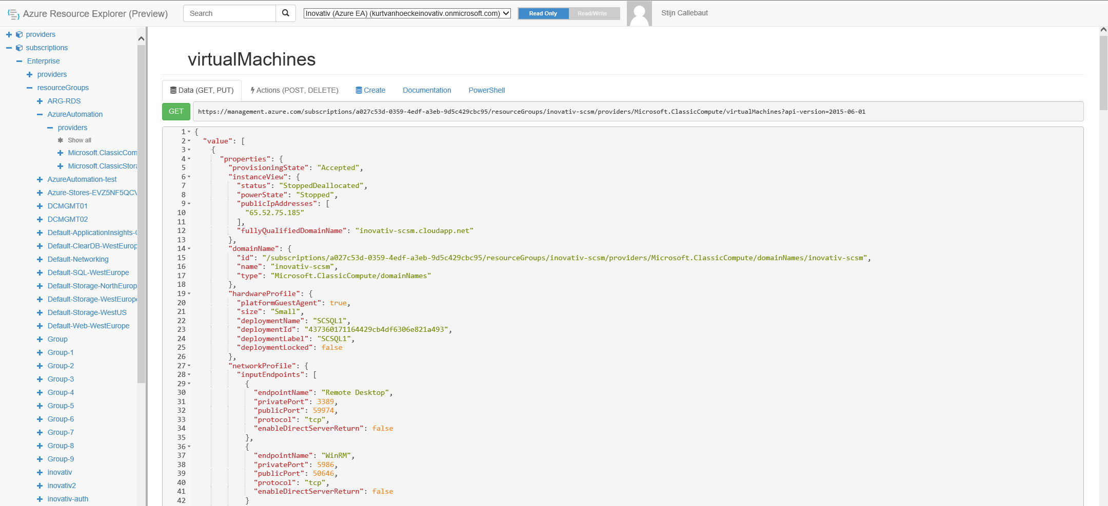
Getting started
Notes:
Azure resource explorer
https://resources.azure.com

Slide 22
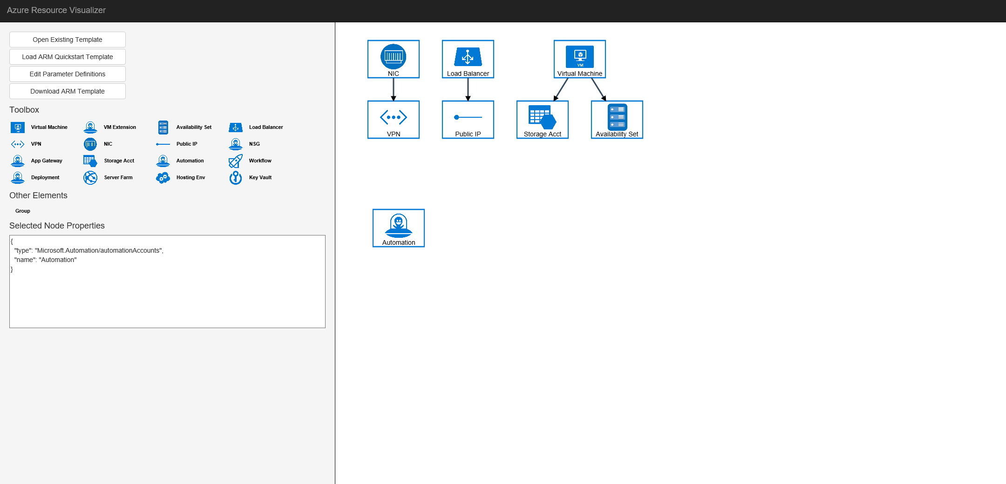
Getting started
Notes:
Azure resource manager visualizer
http://armviz.io/#/
https://github.com/ytechie/AzureResourceVisualizer by Jason Young

Slide 23
Resources – Getting started
Azure QuickStart Templates
https://github.com/Azure/azure-quickstart-templateshttp://azure.microsoft.com/en-us/documentation/templates/
ARM Template Documentation
https://msdn.microsoft.com/en-us/library/azure/dn835138.aspx
Azure Resource Explorer
https://resources.azure.com/
Cloud Consistency with Azure Resource Manager
https://gallery.technet.microsoft.com/Cloud-Consistency-with-0b79b775

Slide 24
Resources - Best practices
Best practices for designing Azure Resource Manager templates
https://azure.microsoft.com/en-us/documentation/articles/best-practices-resource-manager-design-templates/
Examples of best practices for implementing templates
https://azure.microsoft.com/en-us/documentation/articles/best-practices-resource-manager-examples/
Security considerations for Azure Resource Manager
https://azure.microsoft.com/en-us/documentation/articles/best-practices-resource-manager-security/

Slide 25
Resources - Tooling
Visual Studio
Community edition + Azure SDK
Visual Studio Code
Code link
Sublime text
Notepad++
Link to Pete’s article
PowerShell azure module
Link to github

Slide 26
Follow up sessions
Deep-dive on Azure Resource Manager
Room Miami 26/8 – 14.30h
PowerShell DSC, onpremise and cloud
Room Miami 26/8 – 14.30h

Slide 27




















Thanks To All Our Sponsors

Slide 28
We Need Your Feedback
SCU Europe session planner [planning.systemcenteruniverse.ch]
SCU Europe WP app
Watch out for a survey invitation after the conference

